Slide 1
Workday Endowment Accounting
Firstname Lastname, SVP Department

Slide 2
Safe Harbor Statement
This presentation may contain forward-looking statements for which there are risks, uncertainties, and assumptions. If the risks materialize or assumptions prove incorrect, Workday’s business results and directions could differ materially from results implied by the forward-looking statements.
Forward-looking statements include any statements regarding strategies or plans for future operations; any statements concerning new features, enhancements or upgrades to our existing applications or plans for future applications; and any statements of belief. Further information on risks that could affect Workday’s results is included in our filings with the Securities and Exchange Commission which are available on the Workday investor relations webpage:
Workday.com/company/investor_relations.php
Workday assumes no obligation for and does not intend to update any forward-looking statements.
Any unreleased services, features, functionality or enhancements referenced in any Workday document, roadmap, blog, our website, press release or public statement that are not currently available are subject to change at Workday’s discretion and may not be delivered as planned or at all.
Customers who purchase Workday, Inc. services should make their purchase decisions upon services, features, and functions that are currently available.

Slide 3
ONE CONSUMER UI
PROJECTS
EXPENSES
PROJECT
BILLING
PROCUREMENT
REVENUE
ANALYTICS
INVENTORY
ORGANIZATIONAL STRUCTURES
SECURITY MODEL
FINANCIALS
TECHNOLOGY
FOUNDATION
INSIGHT APPS
HUMAN RESOURCES
STUDENT
TIME
TRACKING
PAYROLL
RECRUITING
TALENT
BUSINESS PROCESS FRAMEWORK

Slide 4







































97%
In-Production
Implementing
925⁺
Great Customer Experiences
Over 70% Live

Slide 5
Adaptable in the Face of Continuous Change
Teammate
Worker
Business Processes
Labels, Fields & Calculations
Organizations

Slide 6
Access to Real-Time Data
Supplier
Customer
MANAGEMENT
REPORT
Sales
Person
Statutory
REPORT
MGMT
REPORT
Business
Event
Other
MICRO
ANALYTIC
Line of
Business
GAAP
Project
Product
Real-Time Transaction Data

Slide 7









The Enterprise Cloud for HR and Finance
Human Capital Management
Financial Management
Human Resource Management
Workforce Lifecycle Management
Organization Management
Compensation Management
Absence Management
Benefits Administration
Cloud Connect for Benefits
Talent Management
Onboarding
Goal Management
Performance Management
Calibration
Succession Planning
Career and Development Planning
Financials
Accounting and Finance
Management Reporting and Analysis
Governance, Risk and Compliance
Cash Management
Business Assets
Project and Work Management
Grants Management
Endowments
Budgets
Expenses
Expense Reports and Approvals
Spend Authorizations and Freezes
Mobile Receipt Capture
Credit Card Transactions
Multi-Currency and VAT Support
Recruiting*
Internal & External Candidate Sourcing
Headcount, Pipeline , and Sourcing Analytics
Candidate Management
Referrals
Social Media Integration
Procurement
Supplier and Contract Management
Requisitions and Purchase Orders
Invoicing and Settlement
Contingent Labor Mgmt
Time Tracking
Mobile/Web Time Entry
Mobile/Web Time Clock
Real-time Calculation
Basic Scheduling
Time Entry Against Projects
Time Clock Integration
Revenue Management
Contracts
Billing
Revenue Recognition
Payroll
Payroll for US
Payroll for Canada
Cloud Connect for Third-Party Payroll

Slide 8
Goals
Review discovery document and verify scope
Demonstrate basic transactions
Dive deeper into functionality
Uncover any additional gaps
Identify security groups
Identify business processes

Slide 9
Terminology
Gift - Aggregate of Donor Contributions consistently managed for a purpose in an Investment Pool.
Gifts own shares in Investment Pool.
Gifts own the value of the shares in Investment Pool.
Donor - A person/corporation/trust who donates something voluntarily.
Donor Contribution - Financial asset given to non-profit group or institution in form of investment funds or other property.
Investment Pool - Funds from many Gifts aggregated for purposes of investment.
Investment Pool Valuation - Resets Investment Pool share price based on current fair market value of investment pool.
Investment Pool Payout - Distributes income according to income allocation distribution rules in proportion to number of units each gift owns in the pool.

Slide 10
Endowments

Slide 11
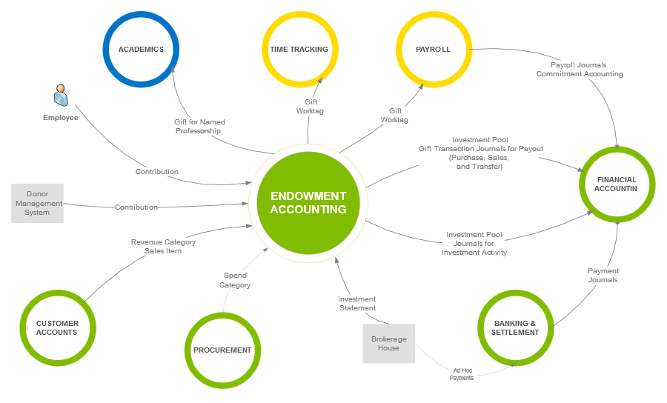

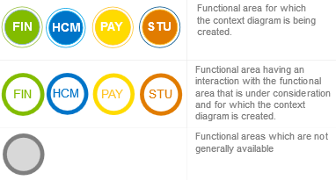
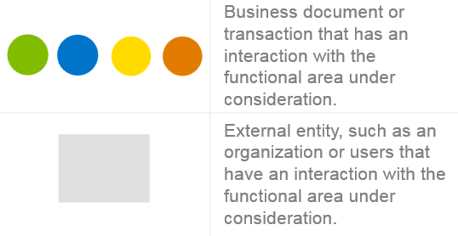
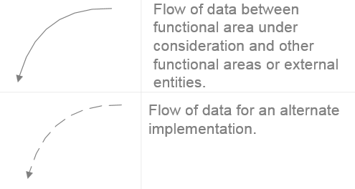
Touchpoints Context Diagram
Notes:
Notes for Consultants
The above diagram displays the touchpoints for the product being reviewed.
Selecting the diagram will display the full size diagram in the Workday Touchpoints Kit.
Please note that the Touchpoints Kit is NOT directly available to customers, but please present the touchpoints diagrams during your design workshop so the customer understands how the product under review fits into the entire Workday unified solution.
Also present the related heat maps during your design workshops so your customer understands the important design decisions at the touchpoints and the shared configuration attributes between Workday products.
Ensure that you have reviewed the Touchpoints Kit before your design session and you are familiar with the contents.
The Touchpoints Kit is NOT available to customers.

Slide 12
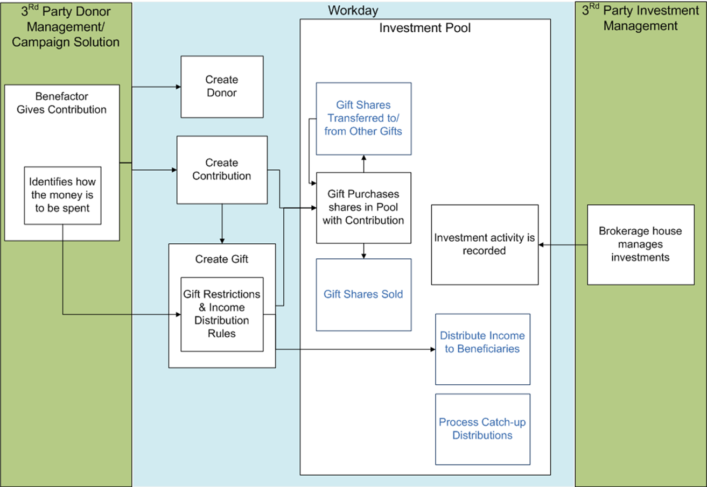
Endowments Process Flow

Slide 13
Three Sections
Contribution to Investment Pool Process
Establish the Investment Pool
Record the Contribution
Buy Shares in the Investment Pool
Investment Pool Processes
Record Investment Statements
Record Investment Pool Valuation
Distribution Processes
Payouts
Transactions in Investment Pool Units

Slide 14
Contribution to Investment Pool Process

Slide 15
Contribution to Investment Pool Process
Create Investment Pool
Create investment Profiles
Create Gift
Buy Shares in the Investment Pool
Create Donor
Create Donor Contribution
Maintain Investment Classification
Maintain Investment Statement Line Types

Slide 16
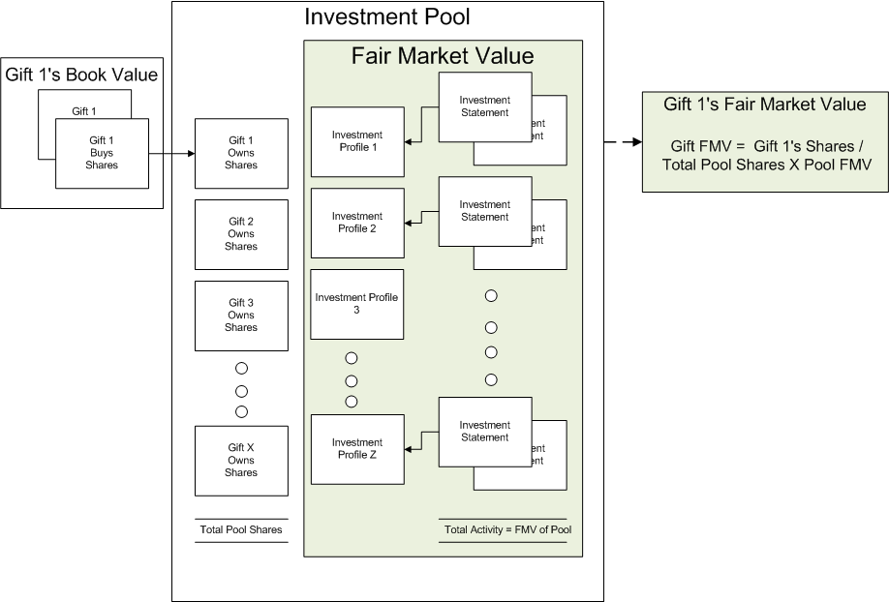
Investment Pools
Investment pools contain shares owned by gifts and pool investments
A unitized accounting system accounts for a gift’s interest in an investment pool on the basis of units or shares.

Slide 17
Investment Pool Set-up
Investment Pool
Investment Classifications
Investment Statement Line Types
Investment Profiles
Payout Rate
Payout Frequency
Map to Revenue Categories
Initial Unit Rate

Slide 18
Maintain Investment Classifications
Investment Pool
Investment Classifications
Investment Statement Line Types
Investment Profiles
Domain
Manager Type
Asset Class
Fair Value Measurement
Composite Grouping
Investment Type
Investment Subtype
Geographic
Market Cap Type

Slide 19
Investment Statement Line Types
Investment Pool
Investment Classifications
Investment Statement Line Types
Investment Profiles
Map to revenue or spend categories

Slide 20
Investment Profiles Set Up
Investment Pool
Investment Classifications
Investment Statement Line Types
Investment Profiles
Create investment profile for an investment pool
Can have gifts in different companies than the company associated wih endowment pool they belong to
Financial Institution definition is required
Select Default Investment Statement Line Types
Map Investment Classifications

Slide 21

Demonstration – Create Investment Pool
Matthew Fong
Investment Pool Manager
Investment Pool

Slide 22
Gifts

Slide 23
Gift Donor Set Up
Gift / Donor Set Up
Create Donor / Donor Contribution
Purchase Investment Pool Units
Create Gift
Create Gift Hierarchy
Donor Types
Gift Types
Gift Purposes
Create at least one gift purpose per gift purpose type

Slide 24
Create Gift
Gift / Donor Set Up
Create Donor / Donor Contribution
Purchase Investment Pool Units
Create Gift
Create Gift Hierarchy
A gift is the initial donation, and may have many contributions from multiple donors
Gift as a Worktag:
May be used as a Worktag on other transactions
Roles may be assigned
Hierarchies may be defined for reporting or role inheritance
Worktags may be assigned to a gift for defaulting on operational transactions
Also default Worktags for share purchase and reinvestment
Specify a reinvestment percentage
Income distribution supports flat amounts along with the required 100% catchall
Custom Fields can be added to Gifts

Slide 25
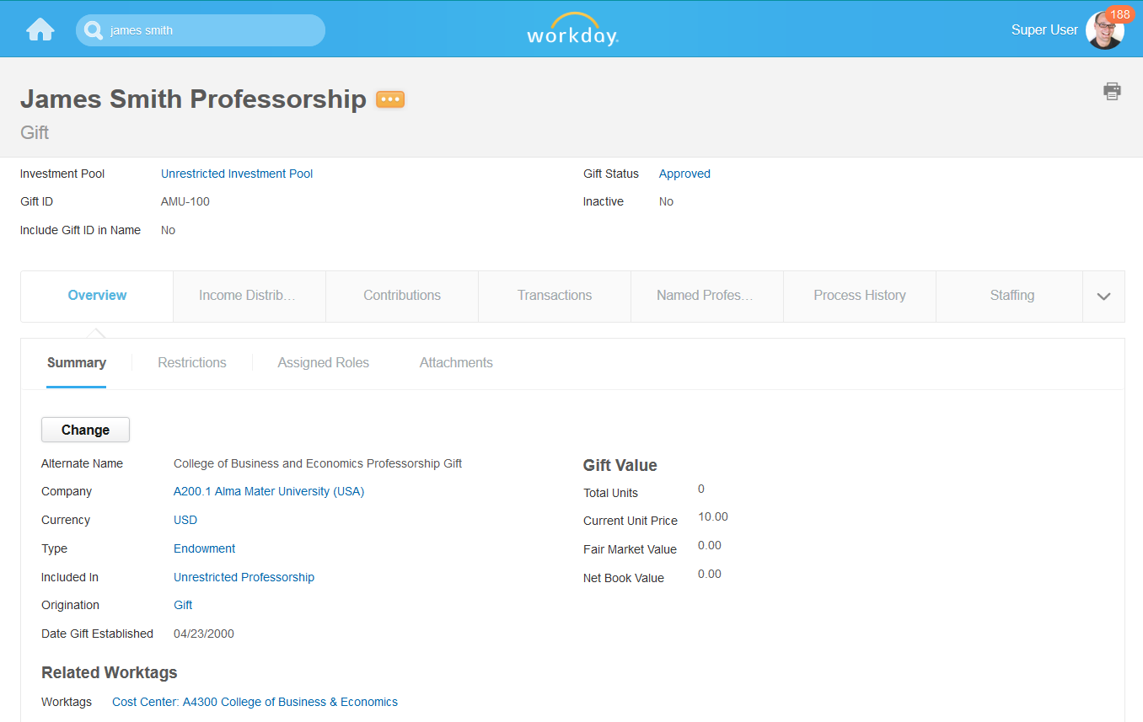
Composite View of Gift
Displays HCM data for “Named Professorships” tied to Gift object
Organized by Tab and by Sub-tab
Controlled edit by sections of the Gift
Edit entire Gift through related action
Notes:
Note: Where possible, use screen shots to illustrate
New or modified configuration tasks/ pages/ options/ capabilities
New or changed pages.
New or changed fields or other page controls.
New or changed field values.
Other new or modified options/ capabilities.
New or modified user tasks and pages, or other downstream impacts (end result of setup).
Changes/enhancements; provide text in PPT slides and notes to accompany screen shots.
If Changes Are To BPs:
Describe new/ modified BPs that support this feature.
If applicable, list other BPs that can include the new BP as a subtask.

Slide 26
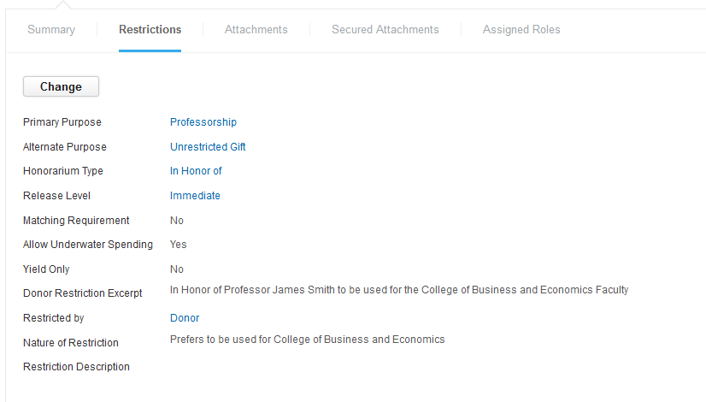
Composite View – Restrictions
Restrictions include:
Primary Purpose
Honorarium Type
Release Level
Y/N reporting fields
Matching required
Allow Underwater Spending
Yield Only
Restricted By
Text Fields
Donor Restriction Excerpt
Nature of Restriction

Slide 27
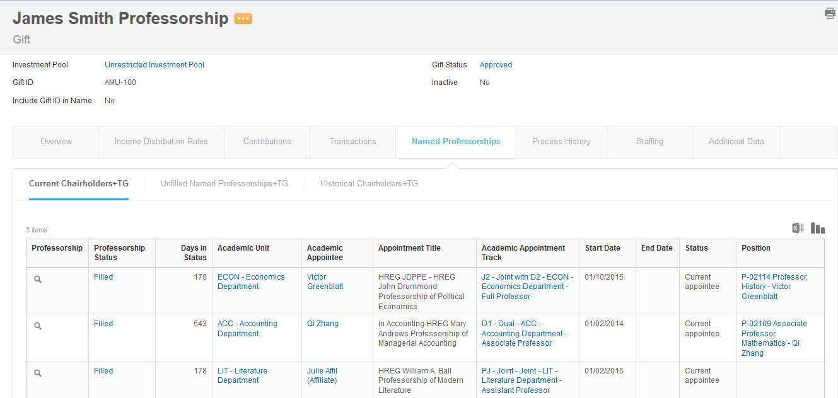
Composite View – Named Professorship / Current Chairholders
Named Professorship tab
Shows if gift has a purpose code tied to Professorship
Sub tabs display HCM data:
Current Chairholders
Unfilled Named Professorships
Historical Chairholders (includes current chair holders)

Slide 28
Create Gift Hierarchy
Gift / Donor Set Up
Create Donor / Donor Contribution
Purchase Investment Pool Units
Create Gift
Create Gift Hierarchy
Use gift hierarchies to group related gifts together for reporting purposes.
You can assign the hierarchy of gifts to specific roles and positions.

Slide 29
Create Donors and Donor Contribution
Gift / Donor Set Up
Create Donor / Donor Contribution
Purchase Investment Pool Units
Create Gift
Create Gift Hierarchy
Create Donors
Donors are shared across all organizations
Create a unique donor for each address
Donor contact information: phone, address, email, instant messenger, and web address
Custom Fields can be added to Donors
Create Donor Contribution

Slide 30
Purchase Investment Pool Units
Gift / Donor Set Up
Create Donor / Donor Contribution
Purchase Investment Pool Units
Create Gift
Create Gift Hierarchy
Purchase investment pool units to record investment of contributions
An investment pool may receive multiple contributions from multiple gifts

Slide 31
Demonstration – Gifts
Matthew Fong
Investment Pool Manager
Create Gift, and Gift Hierarchy
Create a Donor
Create a Donor Contribution
Purchase Investment Pool Units

Slide 32
Investment Pool Processes

Slide 33
Investment Pool Processes
Record Investment Statement
Record Investment Pool Valuation
Record Investment Statements
Record Investment Pool Valuation

Slide 34
Record Investment Statement
Record Investment Statement
Record Investment Pool Valuation
Record investment statements against investment profiles.
Statement activity is summed to determine fair market value for pool.
Shares cannot be purchased if a statement has been entered since the last valuation.

Slide 35
Record Investment Pool Valuation
Record Investment Statement
Record Investment Pool Valuation
Once all statements are recorded for a given period, recording the pool valuation will reset the share price.

Slide 36
Demonstration - Investment Pool
Matthew Fong
Investment Pool Manager
Record Investment Statement
Record Investment Pool Valuation

Slide 37
Distribution Processes

Slide 38
Distribution Processes
Pool Payout
Transactions in Investment Pool Units
Configure pool for payout
Set Payout rate
Create Payout - Ability to override payout amounts when initiating. Results divide into 3 areas
Income distribution
Administrative fee for income distribution
Reinvestment (income distribution)
Run Catch up Payout
User selects gifts that require catch–up distributions
User Specifies amounts and administrative fees
Produces a payout result – same as regular payout except that is flagged as Catch-up
Same BP as Create Payout

Slide 39
Demonstration – Pool Payout
Matthew Fong
Investment Pool Manager
Create Payout
Run Catch-up

Slide 40
Distribution Processes
Pool Payout
Transactions in Investment Pool Units
Sells and transfers use default unit selection from pool. Defaults can be overridden at transaction.
Uses Account Posting Rules – Investment In Pool
Sell investment pool units
Reduces gift’s: Total units and Book value
Reduces pool’s Total number of units
Transfer investment pool units
Book value and share quantity are transferred to target gift
Transactions visible in both gifts – updating total units by amount withdrawn on source gift

Slide 41
Demonstration - Transactions in Investment Pool Units
Matthew Fong
Investment Pool Manager
Sell Investment Pool Units
Transfer Investment Pool Units

Slide 42
Sequence Generators
Investors (if not previously set up)

Slide 43
Worktags
Gift
Gift may be referenced on journals and operational transactions such as expense reports and supplier invoices
Auto-populated on investment pool purchases
Donor
Donor may be referenced on journals
Auto-populated on investment pool purchases
Investment Pool
Investment Pool may be referenced on journals
Auto-populated on investment pool purchases
Custom
Line of Business, Campaign, Channel, etc.

Slide 44
Controls
Configurable Security
Role-based and user-based security groups
Domain and business process policies grant permission to specific tasks
Custom Validations
Configure logic to require/prevent field population
Enforce worktag combinations
Business Process Configuration
Approval steps with configurable logic
For example: routing a requisition, purchase order, or change order for Controller approval if the threshold is exceeded

Slide 45
Custom Validations
Define validation logic to control data quality
Require or prevent field population (with or without conditions)
Allow or disallow specific values based on the value of another field
Validation types
Critical is a hard stop
Warning is a message to the user, but may be bypassed
Validations are executed when the transaction is submitted, not during data entry
Use hierarchies whenever possible to minimize maintenance

Slide 46
Reporting
Standard Reports
Pool Activity Report | Gift Share Activity Report
Pool Balance Report | Gift Share Balance Report
Pool Operating and Non Operating Activity Report | Gift Detail Income Distribution Report
Gift Activity Report | View Gift Payout
Find Gifts | Gift Balance Report
Find Donors | View Investment Pool Transfer
Find Investment Pool | Reinvestment Payout Report
Find Investment Statements | View Investment Pool Sale
Find Investment Pool Purchases | View Investment Pool Payout
Investment Statement Lines | Administrative Payout Report
Pool Balance by Investment Classification | Net Payout Report
Pool Income by Investment Classification

Slide 47
Integrations

Slide 48
Web Service
Get Donor Contributions | Get Donor Contributions Request
Get Donors | Get Donors Request
Get Investment Pool Purchases | Get Investment Pool Purchases Request
Get Investment Pool Transfers | Get Investment Pool Transfers Request
Get Investment Statements | Get Investment Statements Request
Put Donor | Put Donor Request
Submit Investment Pool Purchase | Submit Investment Pool Purchase Request
NB Submit indicates a business process exists.

Slide 49
Web Service
Submit Investment Statement | Submit Investment Statement Request
Get Basic Gifts | Get Basic Gifts Request
Get Gifts | Get Gifts Request
Get Grant Hierarchies | Get Grant Hierarchies Request
Put Basic Gift | Put Basic Gift Request
Submit Gift | Submit Gift Request
Get Approval Level | Put Approval Level
NB Submit indicates a business process exists.

Slide 50
Conversion

Slide 51
Data Conversion
Gifts
Load Active Gift Purposes and Types
Load Active Gifts with and Gift Hierarchies
Donor
Load Active Donors Types
Load Active Donors
Load Active Donor Contributions
Investment Pools
Load Active Payout Rates
Load Active Payout Frequencies
Load Investment Statement Line Types
Load Active Investment Pools with Current Valuations
Investment Profiles
Load Active Investment Profiles with Payout Rules
Load Active Investors
Load Active Unit Selection Method

Slide 52
Security

Slide 53
User-Based Security Groups
None specific to Endowment Accounting

Slide 54
Role-Based Security Groups
Gift Manager (On Gift, Gift Hierarchy)
Primary manager for assigned gifts
Access to gift spend analytics.
Approval authority for financial business processes
Gift Financial Analyst (On Gift, Gift Hierarchy)
Perform financial reporting functions for assigned gifts. For example, trial balance, financial statements, and spend analytics.
No approval authority.
Investment Pool Manager (On Company, Company Hierarchy)
Perform investment pool functions for assigned organizations. For example, creating and maintaining contributions, gifts, and investment pools.
Approval endowment business processes.

Slide 55
Integration System Security Groups
Endowment System
Integrate to third party Donor systems
Integrate to third party Financial Investment systems

Slide 56
Domains
Endowment Accounting has the following domains:
Manager Reports: Endowments
Process: Endowments
Reports: Endowments
Set Up: Endowments
Set Up: Endowments Secured Attachments

Slide 57
Business Processes

Slide 58
Business Processes
Donor Contribution Event
Gift Event
Investment Pool Adjustment Event
Investment Pool Payout Event
Investment Pool Payout Rate Event
Investment Pool Purchase Event
Investment Pool Sale Event
Investment Pool Transfer Event
Investment Statement Event

Slide 59
Action Items

Slide 60
Next Steps
Extract and massage data from legacy system(s)
Donor master
Gifts
Investment pools

Slide 61

Questions

